Slide 1
Object class in Java
The java.lang.Object class is the parent class of all the classes in java by default. In other words, it is the topmost class of java.
java.lang.Object class is the root of the class hierarchy. Every class has Object as a superclass. All objects, including arrays, implement the methods of this class.
The Object class, in the java.lang package, sits at the top of the class hierarchy tree. Every class is a descendant, direct or indirect, of the Object class. Every class you use or write inherits the instance methods of Object. You need not use any of these methods, but, if you choose to do so, you may need to override them with code that is specific to your class.
Object
….
….
….
….
….

Slide 2
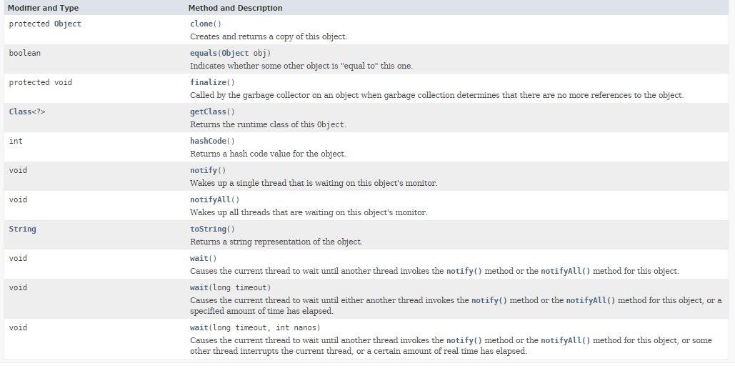
Object class in Java
The Object class provides some common behaviors to all the objects such as object can be compared, object can be cloned, object can be notified etc.

